Slide 1
Pathfinding
Characters typically are on the move.
Using some behaviour.
  What have we used so far?
But what are the difficulties?
  Maybe we don’t have a target
  Is the destination moving or stationary?
  Are there any obstacles?
  Are the obstacles moving?
  What is the terrain like?

Slide 2
Simple Pathfinding
Line of Sight (LoS) and Bresenham algorithms are good
But how do we deal with obstacles?
If obstacle density is low then
  If target is in Line of Sight then use LoS to compute move
  Otherwise move in a random direction
Because obstacles are few, random moves will quickly place entity back in unblocked Line of Sight
Notes:
Bresenham's line algorithm is an algorithm that determines the points of an n-dimensional raster that should be selected in order to form a close approximation to a straight line between two points.

Slide 3
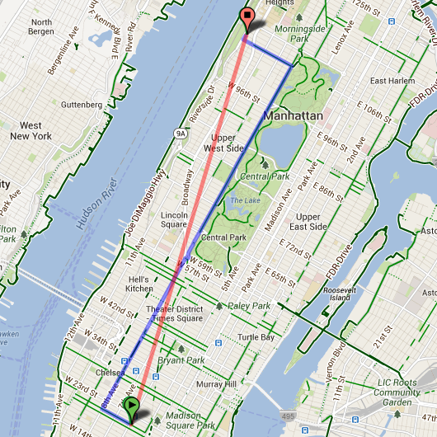
Smarter Pathfinding
Use LoS or Bresenham to compute path to target
Follow path until obstacle is met
Then trace path around obstacle
  (see later for how)
When do we stop tracing?
We stop tracing when either:
  LoS is re-established with target
  We intersect original LoS path
  Manhattan versus Euclidian distance anyone?
Finite State Machine perhaps?

Slide 4
Breadcrumb Pathfinding
Hansel & Gretel, Scent trail, footprints, ion trail, etc.
Target leaves an (in)visible trail behind
If we cross trail we follow it
Complexity of trail is irrelevant
We store trail of entity in simple data structure
  Array is prob. best
    Fixed size, low overhead, low complexity

Slide 5
Breadcrumb Algorithm
  Point theTrail[MAX]; //MAX = Desired Trail length
Array is sorted
  theTrail[MAX-1] is oldest
Initialise to empty
  For(int i=0; i<MAX; i++)
  theTrail[i] = Point(-1,-1);
  //Assume (-1,-1) does not exist in game geometry
Record Target’s/Player’s moves
  For(int i=0; i<MAX-1; i++)
  theTrail[i+1] = theTrail[i];
  theTrail[0] = Target.Location;

Slide 6
Breadcrumb Algorithm
Found = -1;
For(int i=0; i<MAX; i++)
if (Adjacent(theTrail[i],unit.Location) == true)
found = i;
break;
If (found >= 0)
unit.Location = theTrail[found];
Else
Do-LoS();
Ordering theTrail by newest to oldest position avoids unnatural movement when player back tracks.
Any issues here?

Slide 7
Path Following
Often we want to move in a realistic way even if we don’t have an actual destination
Could just wander()
Or follow some predefined path
e.g. Sentry guard /ship on patrol
Label points on the map which are part of the path
  Path can be wide e.g. a road
All other points are considered out of bounds
Movement becomes a matter of containment
  However, don’t want just random movement
  Analyse surrounding terrain and decide on best move

Slide 8
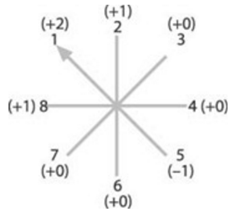
Path Following - Algorithm
From 8 possible directions to move, eliminate those that are not part of the road. Then decide on which of the remaining directions to take.
Keep track of direction of movement (we want to move in the same general direction)
Assign a weighting to each direction of movement
Traverse the direction array in search of most highly weighted direction

Slide 9
Wall Tracing
Rationale
  An Exploration Technique instead of targeted movement
  No End Point or destination
Examples
  Maze Navigation
  Random Movement
Allows NPC’s to explore environment in search of power ups, treasure, weapons, players, doors etc.
Entities interact with environment in a semi-random/predictable way

Slide 10
Algorithm
Entity always moves to the left
  Whenever it is possible to do so!
Otherwise move straight ahead
  Ye olde Left hand maze navigation technique
Try all four directions in order
  Left, straight ahead, right, back
Until we find a way that is unblocked
Remember Left depends on which way you are facing

Slide 11
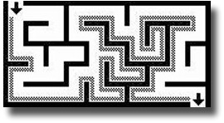
Algorithm
In most cases the algorithm works perfectly
  But it is dependent on the layout of obstacles
In some cases not all areas will be visited
  Can you design a map with such an area?

Slide 12
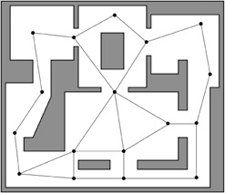
Waypoint Navigation
Pathfinding can be time-consuming and CPU-intensive
Reduce this overhead by:
  Placing (by hand) nodes in the game environment (POVs)
    Every point in LOS of at least one node
    Every node in LOS of at least one other node
  Use
    Pre-calculated paths
    Inexpensive pathfinding methods

Slide 13
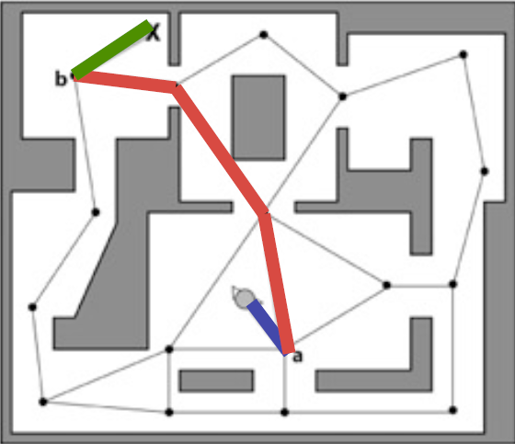
Algorithm
startNode = closest node to NPC and in LOS (node A)
endNode = closest node to target and in target’s LOS (node b)
Calculate path from NPC to startNode
Move NPC to startNode along path
Calculate least cost path from startNode to endNode via node table
Move NPC from node to node along path

Slide 14
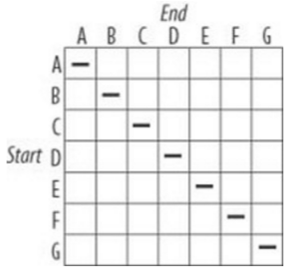
Waypoint Navigation
AI function simply needs to know where nodes are and how they are connected
  Can use a node table to map shortest routes

Slide 15
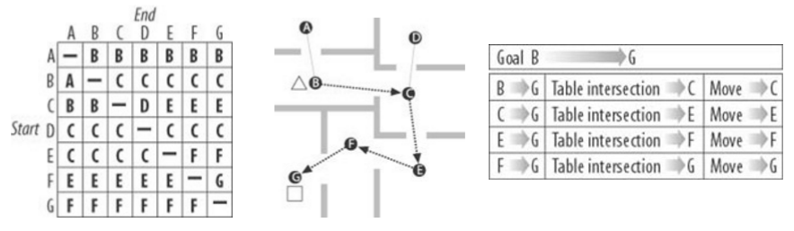
Waypoint Navigation
Example

Slide 16
Waypoint Navigation - drawbacks
  Watch out for blind spots
Automated map generation can be problematic
  Could use expanded geometry
    Expand object dimensions
    Add vertices and edges
    Prune non LOS edges
  Navmeshes (convex polygons) (More on these later)
    Very popular
    Efficient to search
Notes:
Buckland Page 338 (blindspots)

Slide 17
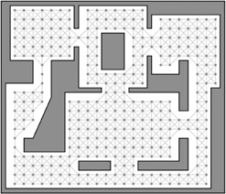
Waypoint Navigation
Finely grained graphs
Improves blind spots and path smoothness
Can be generated using “flood fill”
Need to take NPC’s size into consideration

Slide 18
Waypoint Navigation
Paths as nodes or paths as edges
How would you associate a type of behaviour/movement with a particular path segment?
Could that behaviour requirement change?

